Slide 1
Research Aims
Data: Framingham Heart Study patients with adjudicated laboratory, clinical, and questionnaire measurements, no prior stroke, and complete cases in all candidate covariates (n = 4,275)
Primary Aim: Predict ten-year probability of stroke across different levels of patient risk, stratified by sex
Secondary Aim: Determine if time-varying survival analysis is necessary to account for covariate change over time

Slide 2
Variables of Interest
Outcomes: 10-year stroke
Administrative censoring at ten years, patients with competing risks of death or MI censored at time of event
Covariates: Age, systolic blood pressure, diabetes, CHD, smoking, blood pressure medication, cholesterol, and BMI
Risk Profiles: Calculated at age 40, 50, and 60 for both men & women
No baseline risk (determined as the mean level of continuous variables and the absence of categorical risk factors)
High blood pressure (systolic blood pressure = 160)
Diabetes
High blood pressure and diabetes
Smoking

Slide 3
Primary Analysis
Missingness determined as ignorable from logistic regression with stroke as the predictor of the missing covariates (all p > 0.05) & Little’s MCAR test (p = 0.77)
Variable selection conducted with LASSO-penalized Cox Proportional hazards model, then final Cox PH model fit separately for males & females with selected variables
Selected variables: age, systolic blood pressure, diabetes (forced in model); coronary heart disease & smoking (chosen through variable selection) for both male and female model
C-statistic = 0.77 for males, 0.72 for females

Slide 4
10-Year Stroke Probability, Female
Risk Profile | Age 40 | Age 50 | Age 60
No Risk Factors | 3.09% (2.02%, 4.14%) | 5.58% (4.37%, 6.77%) | 9.98% (7.81%, 12.11%)
High SBP (160) | 4.64% (2.87%, 6.38%) | 8.33% (6.41%, 10.21%) | 14.72% (12.00%, 17.35%)
Diabetes | 6.71% (2.64%, 10.62%) | 11.94% (5.61%, 17.85%) | 20.77% (10.12%, 30.16%)
High SBP + Diabetes | 9.98% (3.85%, 15.73%) | 17.52% (8.47%, 25.67%) | 29.71% (15.67%, 41.42%)
Smoker | 4.29% (2.93%, 5.63%) | 7.71% (5.98%, 9.40%) | 13.65% (10.02%, 17.14%)
10-Year Stroke Probability, Male
Risk Profile | Age 40 | Age 50 | Age 60
No Risk Factors | 4.00% (2.70%, 5.28%) | 6.73% (5.09%, 8.34%) | 11.23% (8.44%, 13.94%)
High SBP (160) | 7.62% (4.97%, 10.19%) | 12.66% (9.52%, 15.70%) | 20.66% (16.01%, 25.05%)
Diabetes | 9.94% (4.97%, 14.66%) | 16.39% (9.32%, 22.90%) | 26.35% (15.58%, 35.75%)
High SBP + Diabetes | 18.41% (9.20%, 26.69%) | 29.37% (17.30%, 39.67%) | 44.79% (28.65%, 57.28%)
Smoker | 6.54% (4.91%, 8.14%) | 10.92% (9.10%, 12.69%) | 17.92% (14.33%, 21.36%)

Slide 5
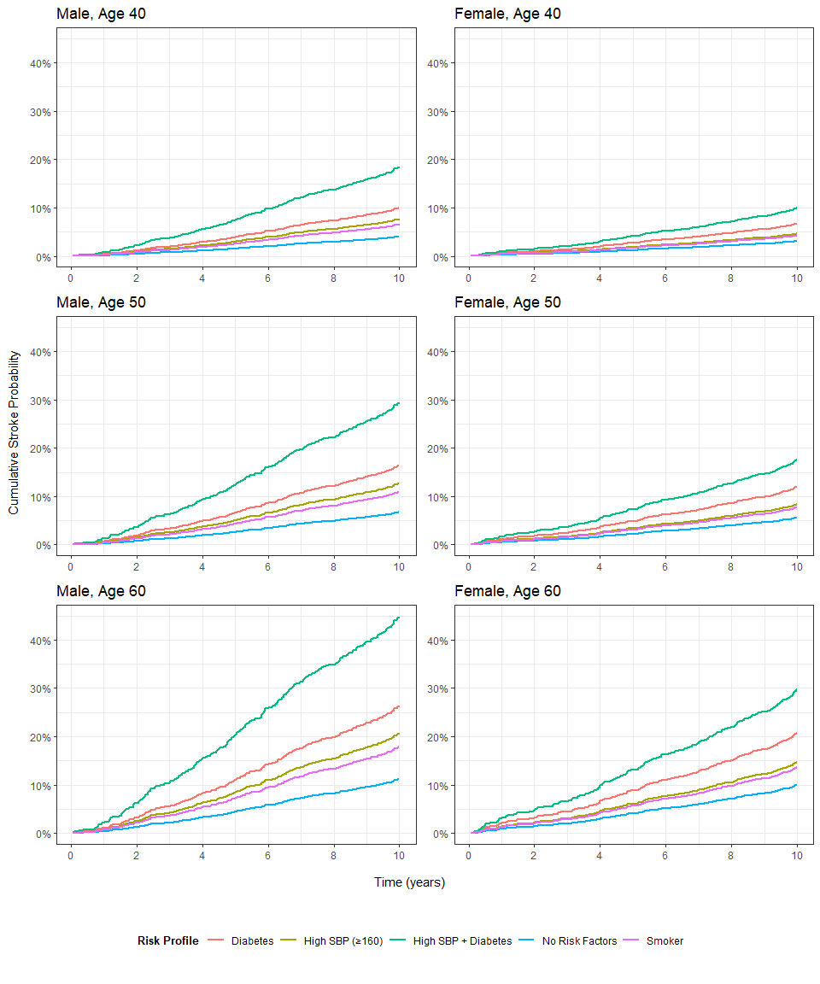

Slide 6
Secondary Analysis Results
Increases in average systolic blood pressure, incidence of diabetes and coronary heart disease, and use of blood pressure medication
Decrease in smoking
Time-varying analysis may be more precise by accounting for changing baseline states due to worsening health outcomes over time, reducing bias and leading to more accurate hazard ratios
 | Period
Characteristic | 1 N = 3,1971 | 2 N = 3,1971 | 3 N = 3,1971
Systolic BP | 130.12 (20.07) | 135.64 (21.59) | 140.19 (22.93)
Total Cholesterol (mg/dL) | 235.41 (44.01) | 249.97 (44.93) | 236.56 (44.39)
(Missing) | 32 | 109 | 210
Smoker | 1,522 (48%) | 1,391 (44%) | 1,094 (34%)
BMI | 25.74 (3.97) | 25.86 (4.04) | 25.90 (4.08)
(Missing) | 7 | 9 | 14
Diabetes | 58 (1.8%) | 105 (3.3%) | 250 (7.8%)
Blood Pressure Medication | 77 (2.4%) | 275 (8.8%) | 414 (15%)
(Missing) | 40 | 75 | 437
Coronary Heart Disease | 74 (2.3%) | 178 (5.6%) | 350 (11%)

